Slide 1

Programming in Scratch
Lesson 6: Iteration

Slide 2
Objectives
In this lesson, you will learn how to use:
define iteration
identify patterns in programming code
use iteration to make programs shorter and easier to code.

Slide 3
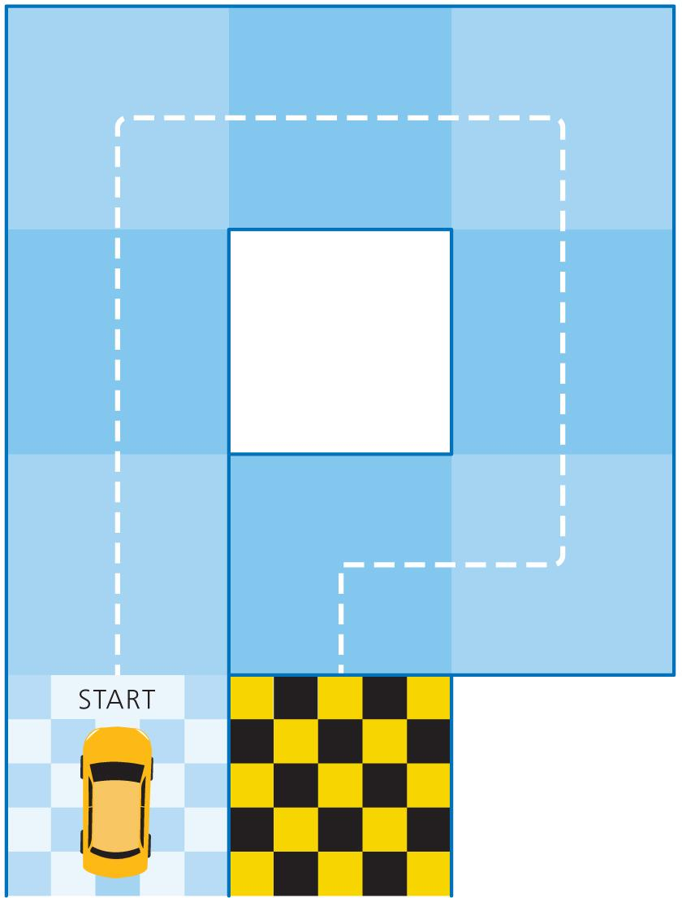
Racing car
Do you remember this track from Lesson 1?
Write a sequence of instructions that uses as few lines of code as possible to get the car from the start to the chequered flag.
The only commands the car understands are:
Move X square(s) forward
Turn X degrees right
Turn X degrees left
Repeat X times

Slide 4
Programming constructs
Previously, we have looked at sequencing and selection and how these work in programming.
Sequencing and selection are two of three key programming constructs:
Sequence
Selection
Iteration
These three concepts are crucial to allow us to solve problems, both in programming and day to day.
Today we will focus on iteration.

Slide 5
Iteration
Iteration is when a set of instructions is repeated. It is used when a program needs to complete the same process multiple times to make programs shorter and easier to code.
Iteration can also be referred to as using a loop.
The most common form of iteration in Scratch is the ‘repeat’ block. You set how many times you want something to repeat, or ask it to repeat until a condition is met.

Slide 6
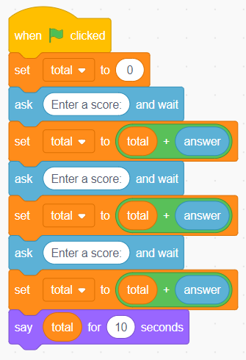
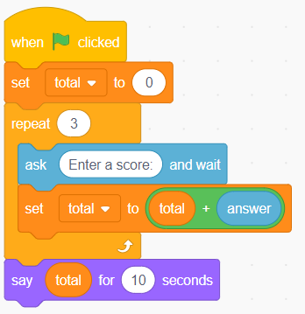
Iteration
Here are two programs that ask the user to enter three scores. They add the scores and display the total. Both programs do exactly the same thing, but the one on the right makes use of iteration.
The repeated blocks are placed inside the ‘repeat’ block (inside the loop) to reduce the amount of code needed.
Watch Video 6.1.
Doesn’t use iteration: 9 blocks required
Uses iteration: 6 blocks required

Slide 7

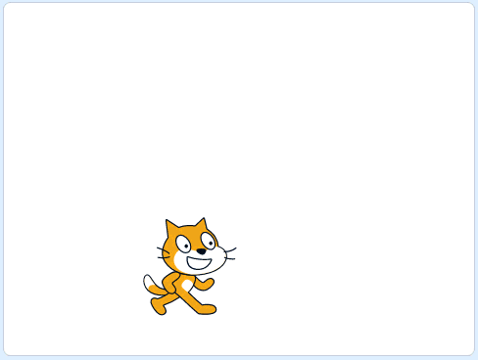

Activity 6.1: Octagon
Example of finished solution
Example of extension 1

Slide 8
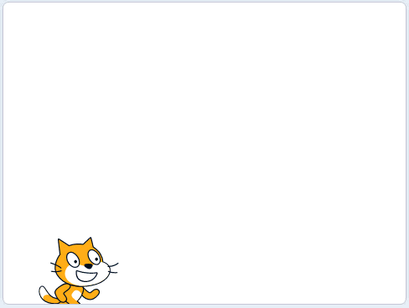
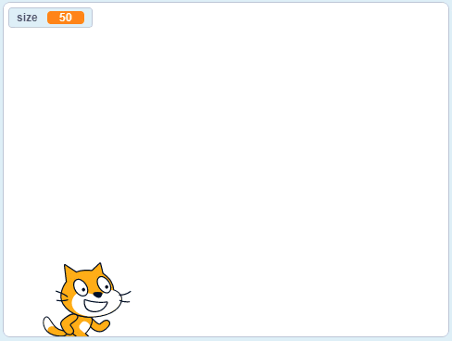
Activity 6.2: Squares
Example of finished solution
Example of extension 1

Slide 9
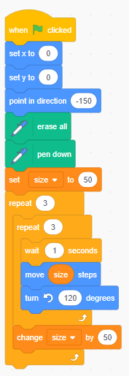
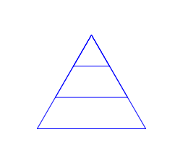
Nested iteration and variables
Draw what you think this code draws when the program is run.

Slide 10
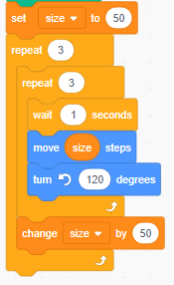
The length of the line is set as a variable, size, before the outer loop starts. It is set at 50.
The outer loop is entered and it goes straight into the inner loop.
The program returns to the beginning of the outer loop and starts this for the second time. It goes straight into the inner loop for a second time.
The inner loop repeats the following 3 times:
  Waits 1 second.
  Moves size steps which, at the moment, is 50.
  Turns 120 degrees left.
The inner loop finishes, size is increased by 50 again, from 100 to 150.
The inner loop finishes, size is increased by 50, from 50 to 100.
The program returns to the beginning of the first loop and it is repeated for the third – and final – time ...

Slide 11
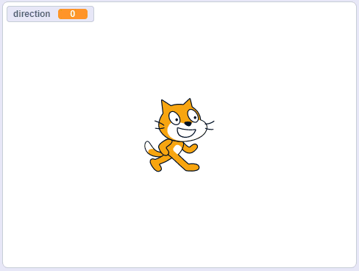
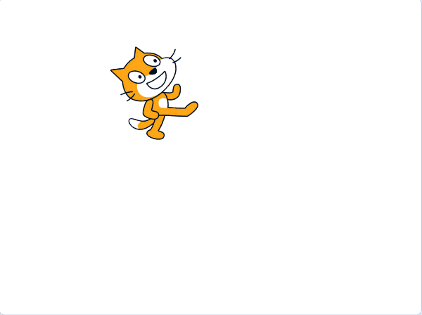
Activity 6.3: Spirograph
Example of finished solution
Example of extension 1

Slide 12
Quiz 6

